Slide 1
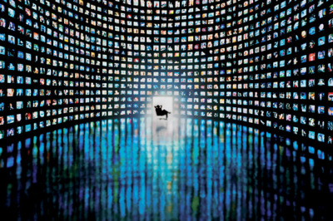
Automated News Broadcast Channel

Slide 2
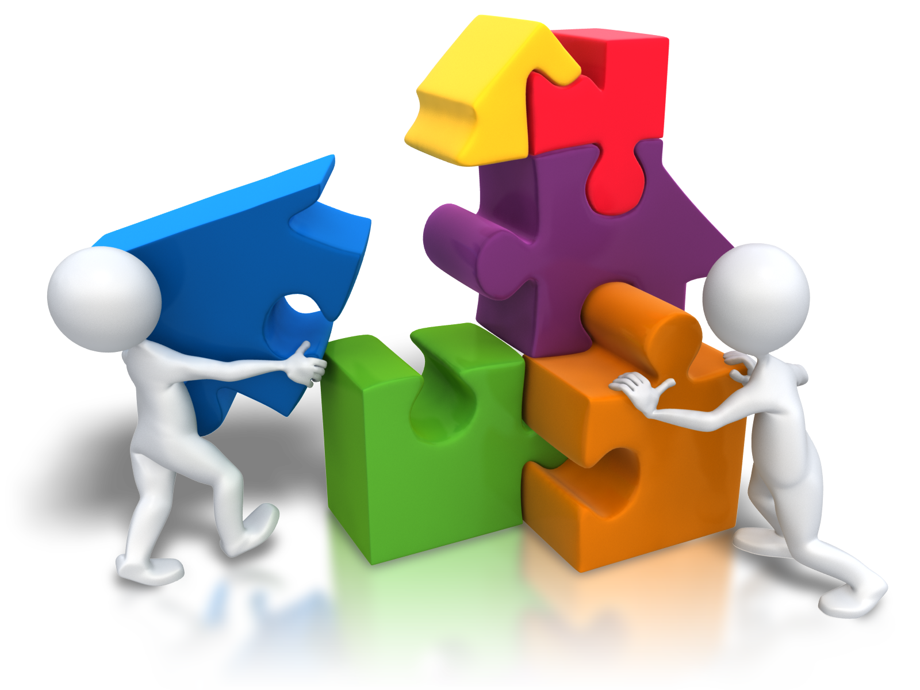
GROUP MEMBERS
Yusra Masood (18B-093-CS)
Rushan Rafiq (18B-087-CS)
Yumna Asim (18B-047-CS)
Shiza Khan (18B-130-CS)

Slide 3


Main Idea
The idea behind this project is to automate the process of news reporting channel by creating a web app which would aggregate the news from different news reporting websites (by scrapping data from it), filter & summarize that data and then present it.

Slide 4




Methods/Working
There would be an admin at the backend who can Log-in to the system.
The admin would then be able to select the list of URLs/News Channel Websites, feed them into the database.
On those websites web scrapping technique would be applied to gather the required data related to news content. This technique would be applied after every set time interval period to refresh the new content.

Slide 5
Methods/Working
Once the data is scrapped it would be filtered, summarized, checked for redundancy and a bulletin is made out of it.
The bulletin would be converted from written to oral form using text to speech
It would then be presented by any animated broadcaster from our website

Slide 6
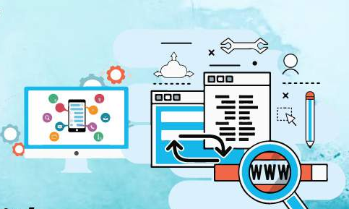


Algorithms & Implementation
Following are the libraries which we can make use of during the implementation of our project:
Urllib module and urllib.request library: A python library which would be used to fetch and open URLS
BS4: This Python library would be used to scrape data from the web pages.
Use of NLP (Natural Language Processing) Technique to synthesize data
gTTS :- Python library to convert text to speech

Slide 7
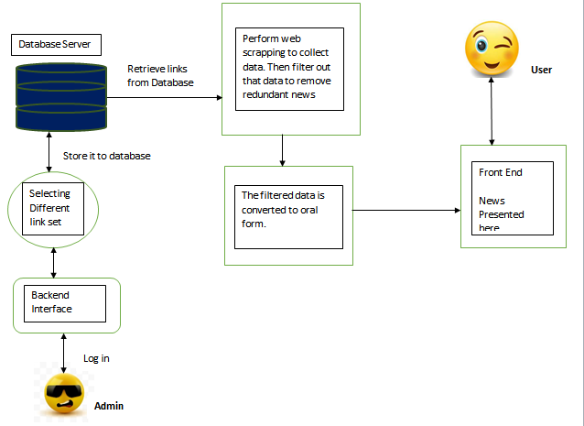
System diagram

Slide 8

Project Deliverables (What would the output be like)
For the Front end part:
A user can watch the news broadcasted to them by the news reporting website

Slide 9
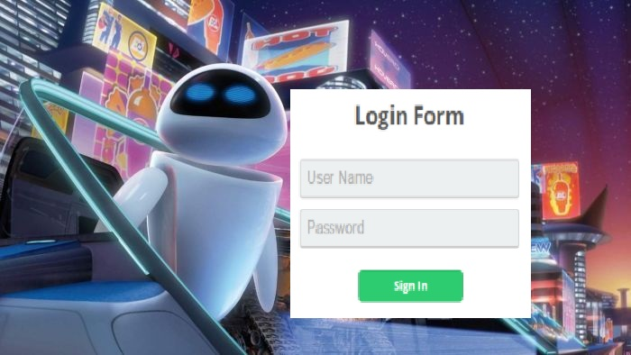
Project Deliverables (What would the output be like)
For the back end part: There would be a login/Sign up Page for the management team of the agency. The particular user would login after which he/she would be directed to the Main (Home) page from where they can then select & apply the desired changes (such as selecting website links for data scrapping).

Slide 10
Why should we work on this project
Some of the advantages of this application are as follows:
News from each channel would be broadcasted.
News accessibility would be fast, less to no time is wasted in searching of the news.
A free website so can be accessed by anyone anytime. Don’t have to go for User Sign up/Login options.
Considering these advantages it can be said that it is an individual idea. By working on a project like this we can further enhance our skills and also get an experience of real world projects.

Slide 11
References
1) https://www.bbc.com/news/technology-40517420
2) https://en.wikipedia.org/wiki/Automated_journalism
3) https://www.nytimes.com/2019/02/05/business/media/artificial-intelligence-journalism-robots.html
4) https://www.theguardian.com/commentisfree/2019/feb/01/why-i-created-a-robot-to-write-news-stories
5) Hayashi, Masaki, Bachelder, Steven, Tsuruta, Naoya. Automatic Generation of News Contents from Blog Posts. Received September 3rd, 2020; Accepted February 10th, 2021.
6) Aakash Rastogi, Anurag Yadav, Arpit Singhal, Pushpendra Tyagi. REPNEWS- COTENT AGGREGATOR FOR NEWS AND TECHNOLOGY . Issue: 05/May-2021.

Slide 12


